Slide 1
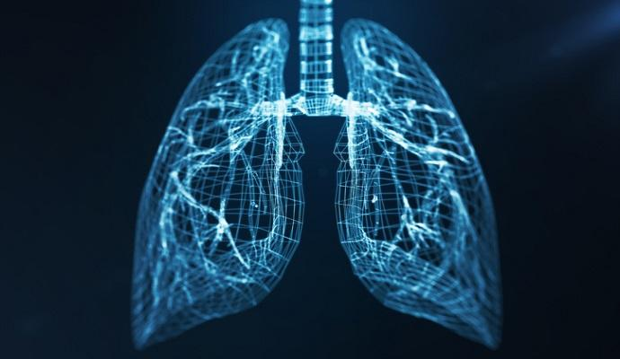
LUNG CANCER DETECTION USING CONVOLUTIONAL NEURAL NETWORK(CNN)

Slide 2
TEAM MEMBERS
BHAVANI DASARI(70079340) - code analysis and implementation ie) designing CNN architecture and model training and evaluation
MANASA SAIRI(700745034) - code implementation and code deployment along with analysing scalability and debugging and logging in required basis.
ANWESH AMMULA(700745034) - over all project coordination, communication and reporting.
YALAVARTHI ROHITH(700745581) - In over all project execution analysis, PPT and final report making.

Slide 3
MOTIVATION
Lung Cancer is most common cancer in men and 3rd most cancer among women. Prediction of lung cancer at earlier stages will reduce the death rate.
Deep learning is one of emerging trends for predicting values and Convolution Neural Network algorithm produces better outcome compared to Machine Learning Algorithms.

Slide 4
OBJECTIVES
Train a CNN model to effectively distinguish between Normal Class, Lung Adenocarcinomas, Lung Squamous Cell Carcinomas classes in medical images. This involves achieving high accuracy, sensitivity, and specificity metrics.
To Develop a Robust and Accurate Model to classify and Predict Lung Cancer Cells.
AND other primary goals are Automated Analysis and workload Reduction with efficiency.

Slide 5
PROBLEM STATEMENT
As we already know Lung Cancer is commonly cause cancer in the world and deaths can be prevented on early detection, but traditional methods like chest X-rays often have limitations in identifying early-stage lung cancer. Current computer-aided diagnosis (CAD) systems may lack the accuracy and generalizability needed for reliable lung cancer detection.
Here is a project which allows Lung Cancer detection using Convolutional Neural Network, which can classify normal lung tissues from cancerous.

Slide 6
RELATED WORK
Data Collection : available datasets such as the Lung Image Database Consortium (LIDC) dataset or the National Lung Screening Trial (NLST) dataset, which contain annotated CT scans of lung nodules.Some research may involve collaboration with hospitals or medical institutions to access proprietary datasets with labeled lung cancer images.
Feature Extraction and Data Preprocessing : CNNs automatically learn hierarchical features from raw image data, eliminating the need for manual feature extraction. We will convert the given images into NumPy arrays of their pixels after resizing them because training a Deep learning Network on large-size images and one hot encoding is also used.
Transfer Learning : A pre trained CNN sequential model is used as a feature extractor to extract features from the preprocessed images. The output is flattened and fed into fully connected layer to classify cancer and non cancer images.
Training : The CNN sequential model is trained using the collected dataset to optimize the model’s parameters for cancerous and non cancerous cell detection.
Testing and Evaluation : A trained model is tested on a separate set of images to evaluate its accuracy and detecting cancerous cells. Various metrics such as accuracy, precision, recall and F1 are used to evaluate the model’s performance.

Slide 7
EXISTING SYSTEM
We had machine learning algorithms like Support Vector Machines(SVMs) and Random Forests have been used for cancer classification tasks but there are few issues like limited automation, Feature Engineering BottleNeck etc.
Computer aided diagnosis(CAD) systems incorporate various image processing techniques to assist radiologists in interpreting medical scans and issues are not ideal for image dataset, limited feature learning.
WHY CONVOLUTIONAL NEURAL NETWORK STACKED UP AND HOW?

Slide 8
CNN are specifically designed for image recognition tasks.
The multi-layered architecture of CNNs enables them to learn intricate patterns from vast amounts of data, achieving higher accuracy in cancer detection compared to simpler machine learning models.
Unlike CAD systems that might require manual feature engineering, CNNs automatically learn relevant features from images during training process.

Slide 9
PROPOSED SOLUTION
In proposed solution, data for training and testing is collected from Kaggle dataset. This dataset includes 5000 images for three classes of lung conditions:Normal Class, Lung Adenocarcinomas, Lung Squamous Cell Carcinomas. We used TensorFlow library to build our CNN Model and framework used is Keras.
Model Architecture we used to implement is sequential model and We have got accuracy of 90% ie) our model’s prediction is correct 90% of the time.

Slide 10
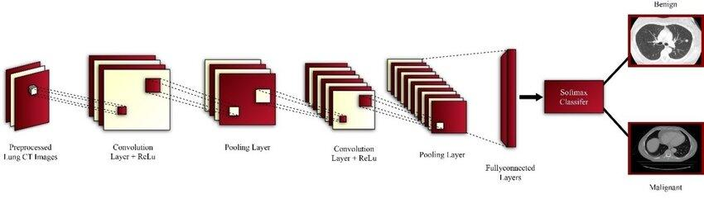
MODEL ARCHITECTURE - SEQUENTIAL MODEL
Three Convolutional Layers followed by max pooling Layers.
The Flatten layer to flatten the output of the convolutional layer.
Then we will have two fully connected layers followed by the output of the flattened layer.
We have included some batch normalization layers to enable stable and fast training and a Drop layer before the final layer to avoid any possibility of overfitting.
The final layer is the output layer which outputs soft probabilities for the three classes.

Slide 11
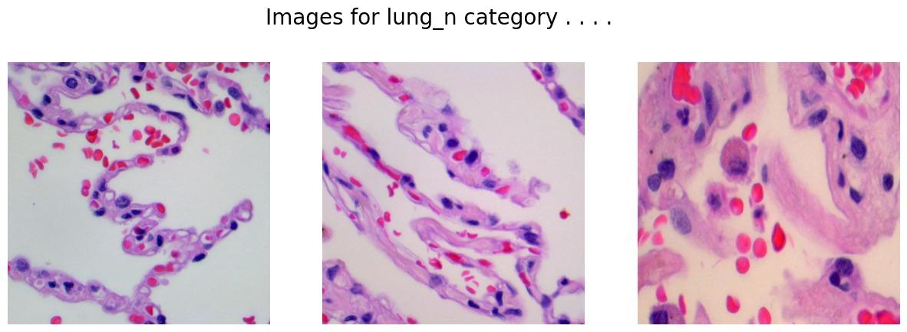
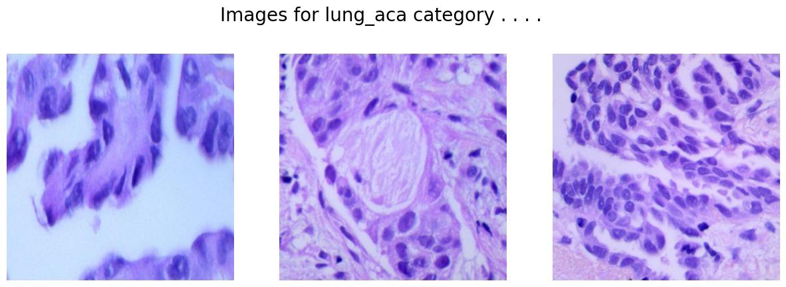
RESULTS

Slide 12
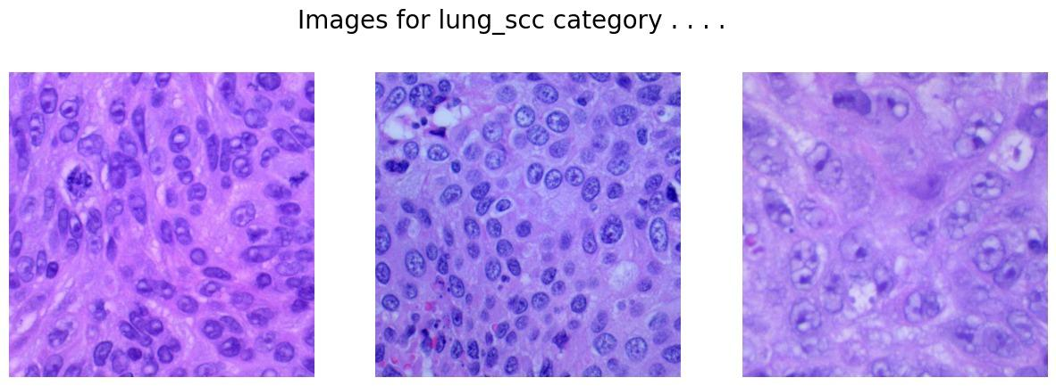
RESULTS

Slide 13
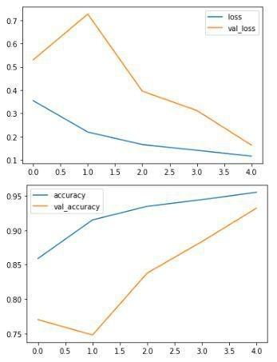
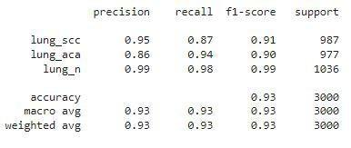
RESULTS

Slide 14
OTHER RELATED WORK
In AI models can be trained on a combination of lung scans, patient demographics, and medical history to potentially improve cancer detection accuracy and risk stratification.
Techniques like Grad-CAM (Gradient-weighted Class Activation Mapping) highlight image regions influencing the model's predictions, providing insights into its decision-making process.

Slide 15
REFERENCES
https://arxiv.org/pdf/1512.00567
https://arxiv.org/abs/2202.08546
https://arxiv.org/abs/1606.09375
https://ieeexplore.ieee.org/document/7890036
Additional References
Keras Sequential Model Documentation: https://keras.io/guides/sequential_model/
TensorFlow Sequential Model Tutorial: https://www.tensorflow.org/api_docs/python/tf/keras/Sequential

Slide 16
THANK YOU

